Slide 1
Rethinking YANG-based Service and Network Management in the Era of Agentic AI
An investigation into how Agent-to-Agent (A2A) communications impact the traditional service, network, and device YANG model.
draft-mw-nmop-yang-ai-challenges

Slide 2
Outline
Background & Goal
Rethinking YANG when the industry shifts towards Agentic AI
Two workflow Examples
Share representative workflow examples in agentic architecture
Core Challenges Analysis
Deep dive into major gaps impeding the effective AI-YANG integration
Potential Ways Forward
Exploring technical and architectural pathways to bridge the identified gaps
Open Discussion
Interactive Q&A, feedback sharing, and collaborative idea exchange

Slide 3
Background and Goal
Background
Agentic AI introduces new paradigms for network automation
There is a gap in understanding how the Agentic AI interacts with YANG.
What we are targeting is the ultimate state of zero-touch/human-out-of-loop, not just AI-assisted OPS.
Primary Goal
Facilitate community discussion
Identify key gaps that emerge when AI agents generate and operate on YANG data
Establish complementary mechanisms that bridge those gaps

Slide 4

The RFC 8969 Paradigm for Model-driven Automation
RFC8969: A Framework for Automating Service and Network Management with YANG
Orchestrator
Architecture Characteristics
Deterministic workflow
Automation follows rigid, predefined workflows
Hard-coded logic to map service->network->device layers
Highly Structured Interface & Data Modeling
Mandates highly structured YANG data models for every layer
Service YANG Model
Service Orchestration
NETCONF/RESTCONF/Telemetry
Controller
Network YANG Model
Network Orchestration
NETCONF/RESTCONF/Telemetry
Network Devices
Device YANG Model

Slide 5

Shift towards an Agentic AI based Hierarchy
If the pipeline is re-implemented with AI Agents at each/some layers, what would change?
Operator Intent
Orchestrator AI Agent(s)
Interfaces between layers with agents are no longer YANG-driven management protocols – it now could travel alongside natural language intent, agent context, etc.
The intent interpretation and workflow execution could be done by a probabilistic reasoning engine, and the agent autonomously decides which tools/APIs to invoke at which time
parses NL intent → service orchestration
Agent-to Agent communication Protocol
Network AI Agent(s)
Network Orchestration
NETCONF / RESTCONF / Telemetry
Network Devices
execute changes, report results

Slide 6
Workflow Examples

Slide 7
Intent-Driven Service Provisioning/Optimization
1
2
3
4
5
Operator intent
Orchestrator AI agent
Agent Communication
Network AI agent
Device execution
The network operator submits natural language service request
parses intents into a service model representation, confirms with the user, decomposes into structured network model based parameters
YANG-structured data + context metadata sent to network AI agent over Agent-to-Agent communication protocol
Converted to device model based configuration and delivered to network devices via protocols like NETCONF/RESTCONF
Devices apply the configuration change and report execution results back up the chain

Slide 8
Network Troubleshooting
1
2
3
4
Operational intent
Network operational state awareness
Diagnose & Plan
Simulate & Execute
Operator asks the agent to continuously monitor, diagnose, and autonomously repair issues.
Once a fault is identified, the agent determines root cause (e.g., run sequences of OAM tests or perform incident-diagnose RPC) and generates a targeted repair plan.
Agent understand the network operational state in real-time and grasps YANG data such as alarms, network anomalies, and incidents.
Digital-twin simulation validates the fix, then the agent delivers YANG configuration changes to network devices.

Slide 9
Core Challenges Analysis

Slide 10
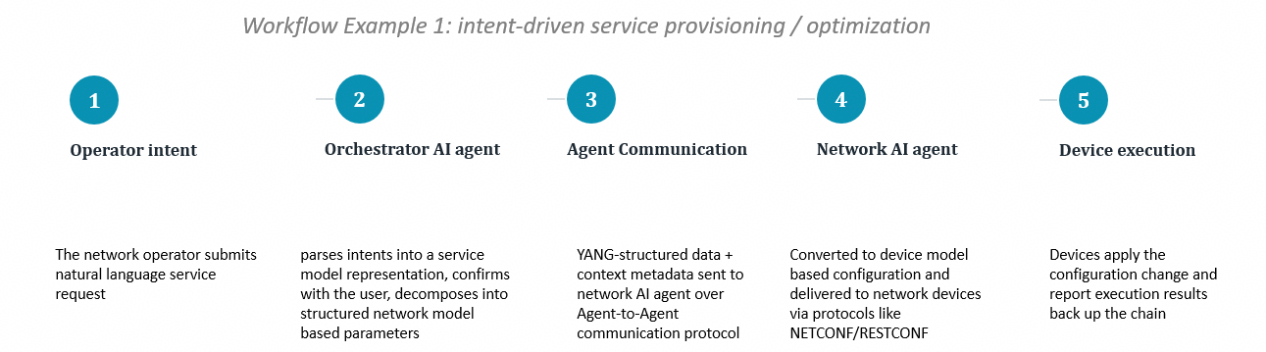
Gap Analysis 1: The Semantic Divide
Orchestrator Agents must prune and simplify intent to fit YANG data model
Natural Language:
Advantages
Empowers human operators to express richer intent, e.g., expectations, constraints, preferences, retry strategies, and fallback rules
Communication protocols like A2A natively support unstructured plain text
Limitations
Could be ambiguous, and lacks the precision needed for network operations
Structured YANG:
Advantages
ensure deterministic, high-efficiency execution with highly structured and validated schema
Limitations
Completely inflexible and has expressiveness limits
The core challenge is translating high-level natural language negotiations into precise YANG representations without losing context.

Slide 11
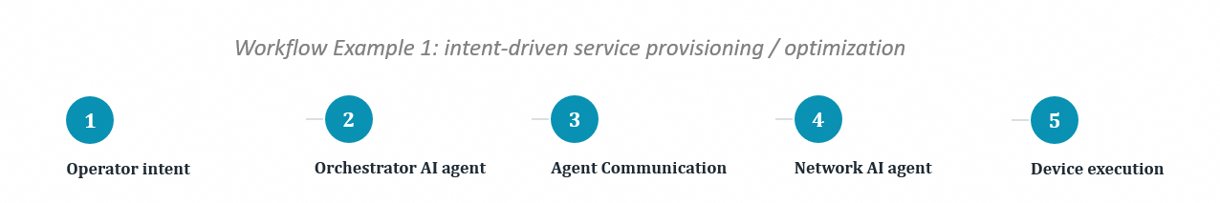
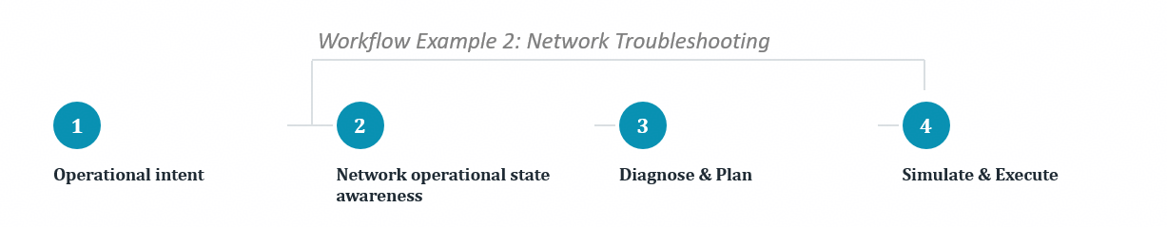
Gap Analysis 2: Token Efficiency and Encoding Overhead
Injecting verbose encoding into the LLM context window adds attention noise, latency, and cost without semantic payoff.
Key Concepts
LLMs don’t read text as humans do – they process tokens. Tokens are the basic units of text that LLMs process.
Each model has a maximum number of tokens it can handle (context window)
Both input (prompt + context) and output (responses) consumes tokens
LLM tokens cost money
Structured formats (JSON/XML) often cost more tokens due to repeated field names/markup.
Highly compressed formats like CBOR solve bandwidth issues but are incompatible with LLMs (LLMs cannot consume raw binary payloads directly)

Slide 12
Gap Analysis 3: Non-determinism Task Handling
The same high-level intent can produce different YANG instance data across invocations; the same observed network state can yield multiple, distinct diagnostic trajectories and conclusions.
Root-causes of Agent non-determinism (Why it happens)
Probabilistic Nature of LLMs: At their core, LLM runs on next-token prediction probabilities, which inherently introduces randomness.
Context drift: even minor shifts in historical context can alter outcomes for identical tasks.
Semantic Ambiguity: Ambiguous natural language instructions allows for multiple interpretations
Key impacts of non-determinism (The Consequences)
Weakened reliability
Configuration Inconsistency: divergent reasoning path can lead to inconsistent YANG config being pushed to devices
Operational Complexity: Troubleshooting a failure becomes even harder if the diagnostic logic varies from run to run.
Operational Risk: randomness in config generation increases the risk of misconfiguration, service impairment, etc.
The core challenge is AI Agents introduces probability that conflicts the deterministic foundations of model-driven automation.

Slide 13
Potential Ways Forward

Slide 14
YANG-driven Operations as AI-Invocable Tools
Network
MCP Server
R1
R2
Tool examples:
get_devices_info
get_vpn_info
get_mpls_info get_interface_info
get_config_diff
commit_check
NETCONF/gNMI
MCP Client
MCP
Agent
R3
R4
R5
Core idea:
refactor YANG-based network operations into AI-invocable tools using the Model Context Protocol (MCP)
The abstraction layer shields agents from low-level YANG syntax and schema complexity, reducing non-determinism risk
Industry exploration:
https://github.com/jillesca/gNMIBuddy
https://github.com/Juniper/junos-mcp-server

Slide 15
Semantic Enrichment via Knowledge Graphs
Network
R1
R2
Operational State
KG builder
Knowledge Graph
Query
Semantic Agent Reasoning
R3
Configuration
R4
R5
Core idea:
add a semantic layer on top of YANG data models to address YANG expressiveness limits via knowledge graph, which can explicitly model concepts absent from YANG, e.g., “preferred vs. optional” and “transient vs. persistent failure”
KGs give AI agents a machine-readable view of network semantics, relationships, and constraints. E.g., for the intent “check why the VPN tunnel is down,” a KG-enhanced agent queries relationships between the affected services and metrics
Related IETF efforts:
https://datatracker.ietf.org/doc/draft-mackey-nmop-kg-for-netops/
https://datatracker.ietf.org/doc/draft-tailhardat-nmop-incident-management-noria/
https://datatracker.ietf.org/doc/draft-ietf-nmop-network-anomaly-semantics/

Slide 16
Declarative Intent/Policy Overlay
YANG-structured payload + overlay
High-level Intent
Declarative Intent/Policy Overlay
Agent
Core idea:
Instead of forcing agents to translate loose, high-level intent directly into rigid YANG leaf nodes, the agent first compiles the intent into a declarative intent/policy overlay
The overlay could explicitly capture invariants, constraints, policies that existing YANG models cannot represent
The overlay is co-delivered alongside the generated YANG instances to lower-layer agents
Industry exploration:
3GPP intent meta model
TMF intent management API

Slide 17
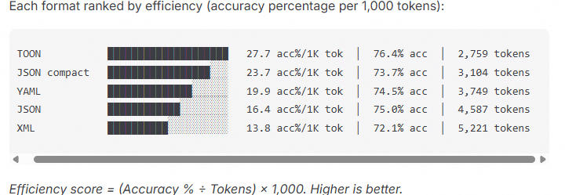
Token-efficient Data Format for LLM input? TOON?
TOON (Token-Oriented Object Notation)
a data serialization format designed specifically for LLM applications.
Zero syntax redundancy: removes closing XML tags and JSON braces
Context window relief: 30%~60% less token consumption
Think of it as a translation layer: use JSON programmatically, and encode it as TOON for LLM input.
Official Repositories:
https://github.com/toon-format/toon
https://github.com/toon-format/spec
{
"users": [
{
"id": 1,
"name": "Alice",
"role": "Admin",
"status": "Active"
},
{
"id": 2,
"name": "Bob",
"role": "User",
"status": "Inactive"
},
{
"id": 3,
"name": "Charlie",
"role": "User",
"status": "Active"
}
]
}
users[3]{id,name,role,status}:
1,Alice,Admin,Active
2,Bob,User,Inactive
3,Charlie,User,Active
TOON achieves 76.4% accuracy (vs JSON‘s 75.0%) while using 39.9% fewer tokens. However, fit for YANG data has not yet been verified.
JSON format
TOON format
Format Comparison
statistics source: https://github.com/toon-format/toon#benchmarks

Slide 18
Mapping Between the Four Paths and the Gaps
Possible Ways Forward
Gap 1
Semantic Divide
Gap 2
Token Efficiency
Gap 3
Non-determinism
① AI-Invocable Tools
✓
✓
② Semantic Enhancement via Knowledge Graphs & Semantic Metadata
③ Declarative Intent/Policy Overlay
✓
④ Token-Efficient YANG Serialization
✓

Slide 19
Comments, Questions, Concerns?

